Slide 1
ROS Topic
21AIE213 - Robot Operating System and Robot Simulation

Slide 2
Previous Section
ROS Installation
Robot Process Cycle
ROS Architecture
ROS Basics
Simple ROS Application Example
Creating a ROS Workspace
ROS File System
Creating ROS Package

Slide 3
Section Overview
ROS Nodes
ROS Topic Overview
Simple Example Overview
Publisher
Subscriber

Slide 4
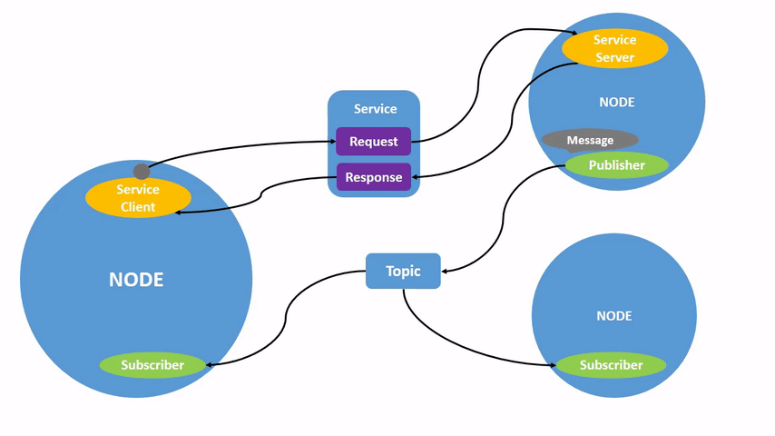
ROS NOdes
Image Courtesy: ros.org​

Slide 5
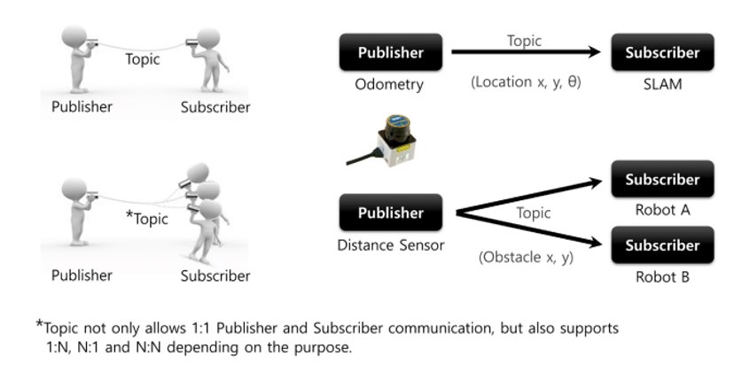
Topic Overview - Recap
Image Courtesy: Prof. Anis koubaa​

Slide 6
TOPIC OVERVIEW
ROS 2 breaks complex systems down into many modular nodes.
Topics are a vital element of the ROS graph that act as a bus for nodes to exchange messages.
A node may publish data to any number of topics and simultaneously have subscriptions to any number of topics.
Topics are one of the main ways in which data is moved between nodes and therefore between different parts of the system.

Slide 7
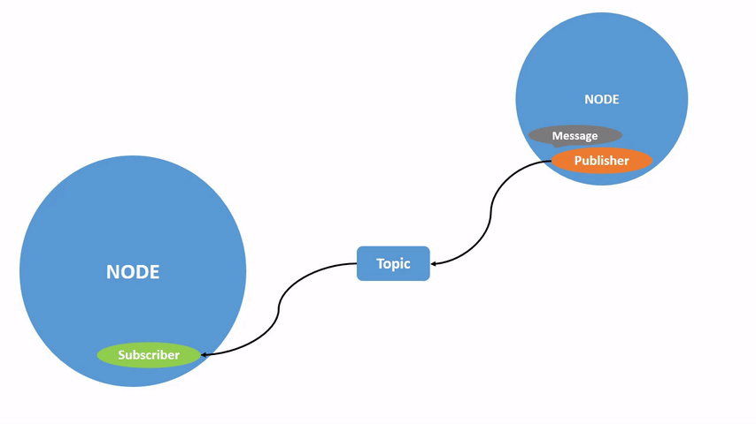
Topics Overview
Image Courtesy: ros.org​

Slide 8
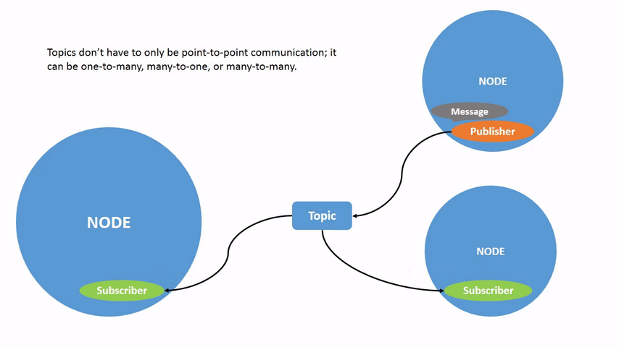
TOPICS OVERVIEW
Image Courtesy: ros.org​

Slide 9
TOPIC Commands
All the interactions between nodes can be viewd using rqt_graph command
Some other useful commands to understand topics are
ros2 topic list
ros2 topic list –t
ros2 topic echo <topic_name>
ros2 topic info
ros2 interface show
ros2 topic pub <topic_name> <msg_type> '<args>'

Slide 10
TOPIC Overview – Writing Publisher
Step 1. Determine a name for the topic to publish
Step 2. Determine the type of the messages that the topic will publish
Step 3. Determine the frequency of topic publication (how many message per second)
Step 4. Create a publisher object with parameters chosen
Step 5. Keep publishing the topic message at the selected
frequency

Slide 11
TOPIC Overview – Writing Subscriber
Step 1. Identify the name for the topic to listen to
Step 2. Identify the type of the messages to be received
Step 3. Define a callback function that will be automatically executed when a new message is received on the topic
Step 4. Start listening for the topic messages
Step 5. Spin to listen for ever

Slide 12
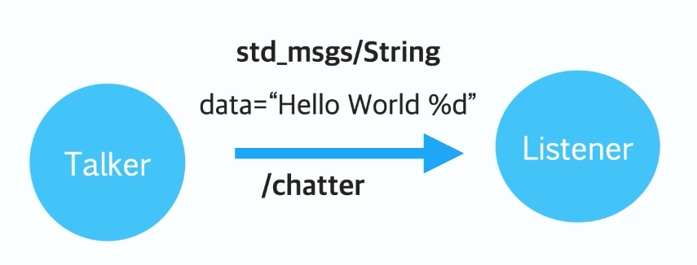
Simple Example Overview
Image Courtesy: Prof. Anis koubaa​

Slide 13
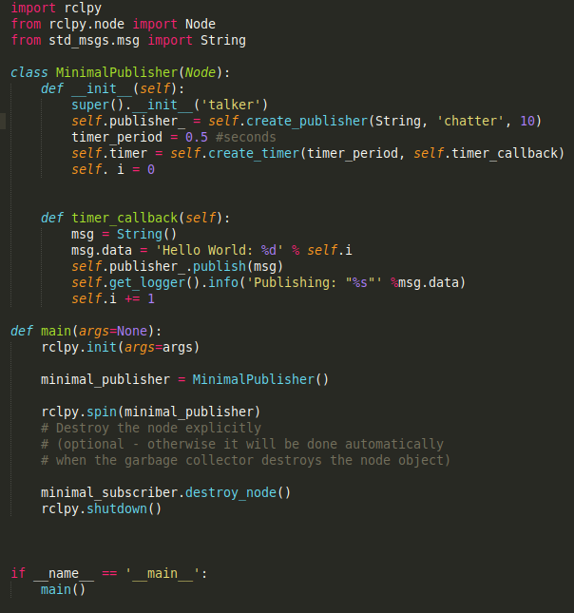
Publisher Node

Slide 14
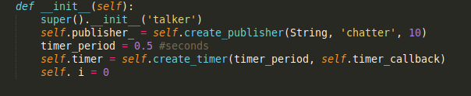
Publisher Node – Creating ROS node and a Publisher Object

Slide 15
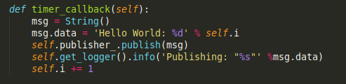
Publisher Node – Publish the ROS Message

Slide 16
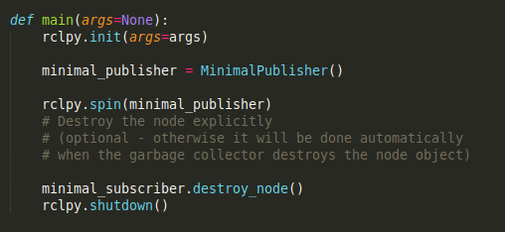
Publisher Node – Main Function

Slide 17
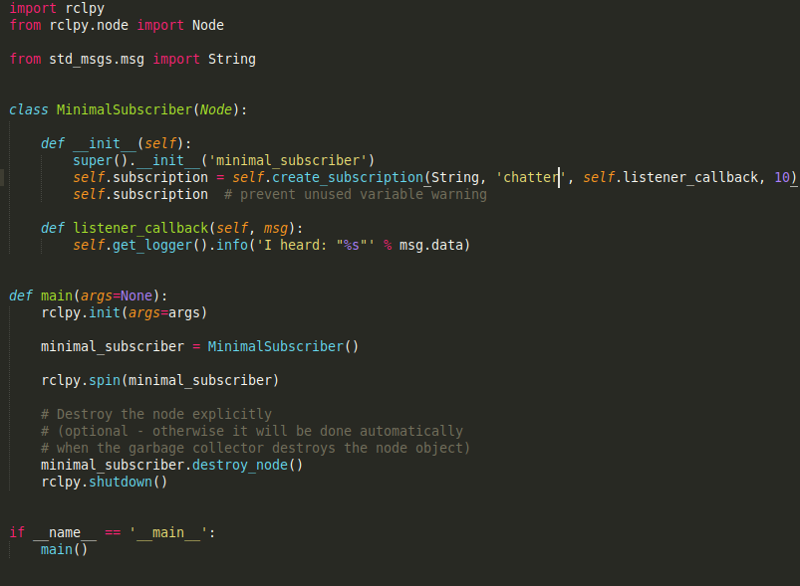
Subscriber Node

Slide 18
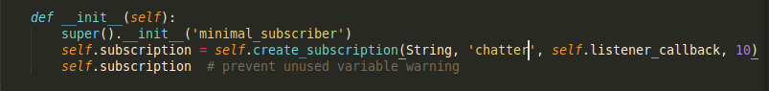
Subscriber Node - CREATING ROS NODE AND A Subscriber OBJECT
Image Courtesy: Prof. Anis koubaa​

Slide 19
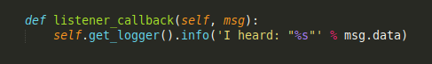
Subscriber Node - Create a Subscriber CALLBACK Function
Image Courtesy: Prof. Anis koubaa​

Slide 20
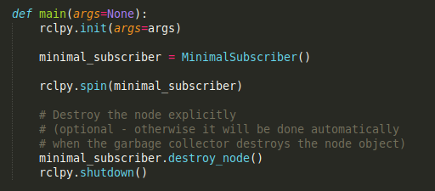
Subscriber Node : Main Function

Slide 21
Thank You !!!

